Slide 1

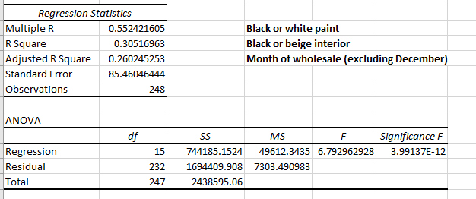
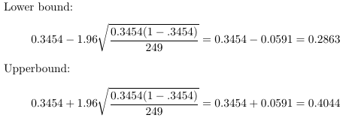
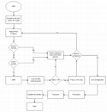
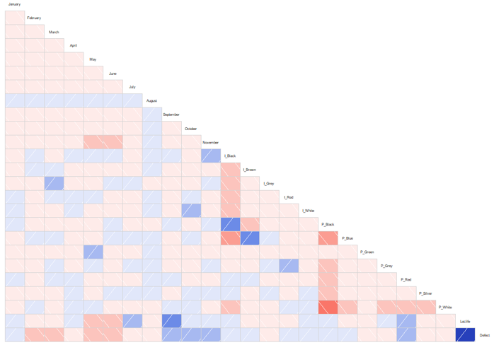
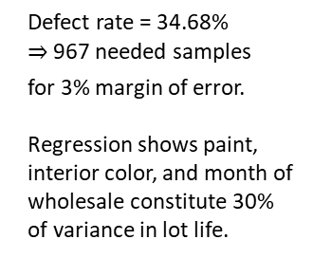
Reduce Average
Vehicle Lot Life
Ben Harwood
Key Dates
Team Launch
6/26
Define
Measure
Analyze
Improve
Control
7/3-7/10
7/11-7/31
8/1-8/14
8/15-8/28
Continual
DEFINE
MEASURE
ANALYZE
IMPROVE
YTD, the average car sat on our lot for 61 days before it sold. When we remove trades and orders, this jumps to 87. Why? Is the paint/interior combination? Are we ordering cars “incorrectly”? Why do some cars sit stagnant and others sell quickly? Can we alter our ordering process to reduce the need for dealer trades (and save $$)?
If we define a defect to be a lot life over 90 days, our Sigma Quality Level is currently 1.875.
Unfortunately, only month of wholesale was determined to truly influence lot life, something we have no control over.
However, we could still consider option configurations on the vehicles to see if certain packages and/or accessories contribute, which we suspect they do.
Defect rate = 34.68%
967 needed samples
for 3% margin of error.
Regression shows paint, interior color, and month of wholesale constitute 30% of variance in lot life.
Average lot life by model
Model distribution across YTD sales
SQL = 1.875
CONTROL
Re-assess in six months to 1 year based on new ordering methodology (if we had results on which to base it).
Methodology would have to be easily changeable in order to adapt to new models, paints, body style changes, and client desires.
Reducing number of defects by 30 will achieve 25% lot life reduction, adjusted SQL of 2.25.
Original Process Map
Questions
To ask
Defect confidence interval
Correlation heat map
(Potential) Adjusted SQL 2.25
Ben Harwood, Brandon Bayer,
Brad Westfall, Don Paparella

Slide 2




Reduce Average
Vehicle Lot Life
Measure
Analyze
Improve
Control
Ben Harwood
Define
Click the boxes for more information. Click me to continue.

Slide 3
Reduce Average
Vehicle Lot Life
Measure
Analyze
Improve
Control
Ben Harwood
Define
Click the boxes for more information. Click me to continue.

Slide 4



Reduce Average
Vehicle Lot Life
Analyze
Improve
Control
Ben Harwood
Measure
Click the boxes for more information. Click me to continue.
Define

Slide 5
Reduce Average
Vehicle Lot Life
Analyze
Improve
Control
Ben Harwood
Measure
Click the boxes for more information. Click me to continue.
Define

Slide 6




Reduce Average
Vehicle Lot Life
Improve
Control
Ben Harwood
Analyze
Click the boxes for more information. Click me to continue.
Measure
Define

Slide 7
Reduce Average
Vehicle Lot Life
Improve
Control
Ben Harwood
Analyze
Click the boxes for more information. Click me to continue.
Measure
Define

Slide 8
Reduce Average
Vehicle Lot Life
Control
Ben Harwood
Improve
All those tests and analyses and the only factor that we know for sure impacts lot life is the month that a vehicle wholesales to us. Unfortunately we have zero control over when vehicles wholesale, so where does that leave us?
Our control charts indicated our process needs some work. This indicates that there is something we have not included in our investigation that is contributing to how long vehicles sit. A strong candidate for this is the option package configuration for the vehicles. We could look at how individual packages and certain combinations impact lot life. However, due to package availability being dependent on the model (and even model year), as well as package inter-dependencies and additional restrictions related to the packages (specifically color and interior options), we will have to do focused analysis on subsets of the data which may, unfortunately, limit the effectiveness of this path as it contributes to the overall inventory.
Click me to continue.
Analyze
Measure
Define

Slide 9

Reduce Average
Vehicle Lot Life
Ben Harwood
Control
Suppose, for sake of discussion, that we WERE able to identify the root cause(s) of lot life and that we WERE able to develop an improvement plan. We would apply the new ordering methodology to cars going forward, and re-assess in six months to a year. The time delay is due purely to the length of the build process, and obviously we need the vehicles configured with the new methodology to sell before we’d even have data to test.
We’d apply all the same techniques described previously on the new sales data to see if the new methodology did indeed reduce our average lot life and reduce the number of required dealer trades, as well as make adjustments based on any new conclusions. The new methodology would have to become dynamic and change as necessary, because new models would come out, new paints and interiors would become available, body style changes would happen, and buyers’ tastes evolve. In the end, assuming we sell the same number of vehicles, reducing our average lot life by 25% will reduce our defect rate to 22.5%, which will boost our SQL to over 2.25. This is a modest improvement, to be sure, but a good starting point.
Click me to continue.
Improve
Analyze
Measure
Define

Slide 10

Reduce Average
Vehicle Lot Life
Ben Harwood
That’s all we’ve got for you. Click me to end.
Control
Improve
Analyze
Measure
Define

Slide 11
The problem
(hopefully the only boring slide)
What contributes to how fast a car will sell? Is it the model? Paint and interior color or combination thereof? Is it certain options? How about when the car arrives to the dealership?
If we can determine what factors really influence how quickly a car sells then we can change the methodology and process we use for configuring vehicles to have more “desirable” and faster selling units. This will have two major impacts on the business:
1) Cars selling faster reduces floorplan costs*
2) Having more “desirable” cars in stock will reduce the number of dealer trades we have to do, which can cost anywhere from $600 to well over $2,000 each time (depending on location).
So what is the plan? Click the Mercedes Star to reveal…
How do we change our vehicle configuration process and methodology to order “better cars” and reduce the average lot life of our inventory by 25%?
Click me to return.
* Floorplan is the revolving credit line dealerships use to purchase new car inventory. Cars that sit accrue more interest.

Slide 12
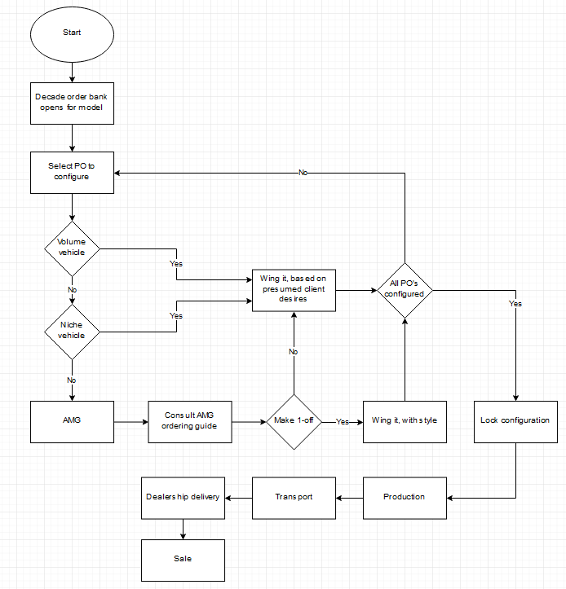
This is the entire process, from our end, to order new car inventory. Things we have no control over:
When order banks open
Allocation – sales volume indirectly impacts our allocation
Production dates (obviously)
Option constraints due to supply issues
When configurations lock in place
Click me to return.

Slide 13
Ick
Defects
(this one may not be very exciting either)
For any vehicle, we shall call the number of days between its wholesale date and sale date its lot life. Define a defect to be any vehicle with lot life greater than 90 days.
We sold 249 cars YTD as of July 31 (NOT including dealer trades and client orders), with 86 defects. That’s a defect rate of 34.54%, which gives us a sigma quality level of 1.875.
Again, ick
While we’re talking about defects, based on the defect rate above we can predict the population defect rate (i.e. all vehicles) to be between 28.63% and 40.44%, as seen here.
Click me to return.

Slide 14
These charts are dynamic. Click the bottom chart to switch to Excel, select the presentation tab at the bottom and you can make adjustments with the model slicer presented. Client orders and dealer trades have been filtered out.
Click me to see more charts.
Click ME to return.

Slide 15
These charts are also dynamic. Click the top chart to access the model slicer. Trades and orders are filtered out.
Click to return to the last page.
Click ME to return.

Slide 16
Data comprises YTD retails, via Mercedes-Benz’ internal inventory management system (with permission), not including courtesy vehicle program cars, and does include dealer trades and client orders. Obviously, client orders do not sit around as clients are generally eager to get their new car, and vehicles that we must trade for don’t either, so subsequent analyses exclude both trades and client orders.
As previously noted, there are 371 total units, of which 249 were not trades or client orders. With each unit we are provided the following:
VIN
Model
MSRP
Retail Date
Color code
Interior color code
Some information had to be manually gathered or calculated, which we acknowledge could introduce error:
Client order – yes or no
Dealer trade – yes or no*
Wholesale date – when the car entered our inventory, whether from the factory or when traded from another dealership
Month of wholesale date, naturally pulled from the wholesale date
Lot life = Retail date minus wholesale date, measured in days
Defect – yes if lot life > 90, no otherwise
Click me to return.
* Only trades that were facilitated for the purpose of immediate sale, not vehicles we got back as part of another dealership’s trade request

Slide 17
Note: due to limitations on data collection, we were unable to measure district and region lot life.
Click me to return.

Slide 18
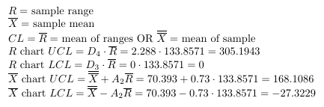
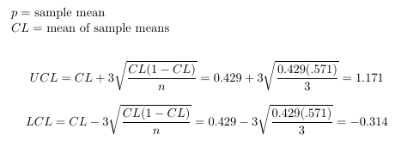
Four samples were taken from each month. We sampled both lot life and defect for each instance. Below are the samples, along with associated p and X-Bar/R charts.
Click me to return.
Lot Life
Defects
To see the calculation tables and formulas, click the data tables.
While each chart shows the data well within control range, none of the charts are especially “bumpy” or jagged, so we conjecture that the process DOES indeed need some improvement. We do acknowledge that sampling more months’ worth of sales data could be more enlightening.

Slide 19

The heat map to the right is a visualization of how the variables are correlated. Due to the mutual exclusivity of many of the variables (e.g. only one month is possible for each unit), only the lower left corner is truly useful. Click the highlighted area to see that section in more detail, along with a couple bits of information.
Click me to return.

Slide 20
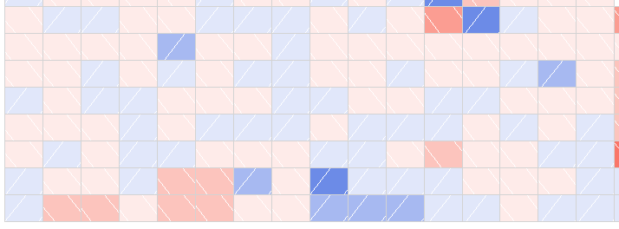
Correlation
cont.
Blue paint with black interior, correlation value is -0.348
Blue paint with brown interior, correlation value is 0.347
None of the other variables have correlation coefficients with magnitude higher than 0.2, and even the three pairs mentioned to the left are fairly low. So we conclude correlation is not a concern insofar as it does not indicate any dependencies, however it is concerning to see how little overall correlation exists between the variables.
September wholesale vs. lot life, correlation value is 0.341
Click me to return.

Slide 21
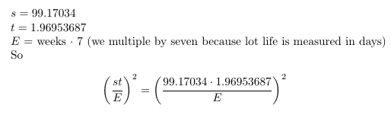
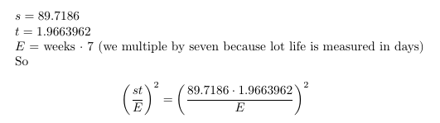
We know the sample standard deviation and our sample size is well over 30, so we use the t value method to estimate our needed sample size to estimate lot life for our entire inventory. On the left side of this page we have the calculation based on all of our sales (including dealer trades and client orders) while the right side does NOT include trades or orders.
Click this box to access Excel and change the number of weeks to estimate lot life.
Samples needed to estimate lot life including dealer trades and client orders.
Samples needed to estimate lot life excluding dealer trades and client orders.
Click for additional sample size information.

Slide 22
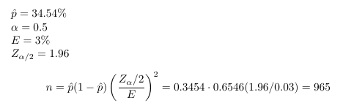
Additionally, given our defect rate of 34.54%, we can see that in order to estimate defect rate to within 3% we need a sample of 965 sales:
Click me to return.

Slide 23




Numerous regressions were performed, too many to include here, in fact. Below we outline those that provided actual insight.
Click me!
Click me to return.

Slide 24
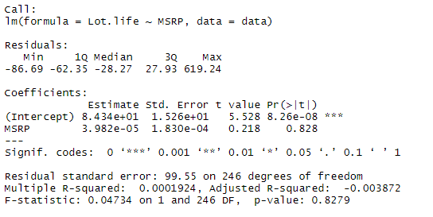
MSRP vs Lot Life
Linear regression comparing MSRP to Lot Life captured a mere 0.019% of the variance, as seen to the right. This is, we suppose, not too terribly surprising considering the wild fluctuation in vehicle MSRP and the associated lot life, as seen in the chart below.
One option we have considered (but was outside the scope of this investigation) is to compare the percent difference between MSRP and base price to lot life.
Click to continue.

Slide 25



Colors and Color Combinations
We approached color and interior color two ways:
First, linear regression comparing paints and interior colors along with the model to lot life was performed and captured 78% of the variance (click box 1 above to see the full report). Additionally, we looked at just paint and interior colors, as well as the combined effect (paint/interior combinations). These captured 7% and 12.8% of the variance, respectively. Box 2 above has those reports.
The other approach we took with the
colors and interiors was to bucket each car
based on the popularity of the paint and
interior combination. Based on the paint and interior color distributions, we made three buckets for paint (Black, White, and Other) and three buckets for interior (Black, Beige, and Other). We then calculated the percentage of the vehicles sold with the associated combinations, and bucketed each vehicle as Common, Very Common, or Less Common if its paint/interior combination percentage was between 10% and 20%, above 20%, or
below 20%, respectively.
With this done, we performed logistic
regression against the Defect variable as well as linear regression against Lot Life. These captured 0.36% and 0.56% of the variance, respectively. Box 3 above will provide these reports.
Click to continue.

Slide 26
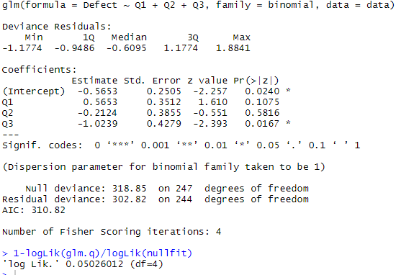
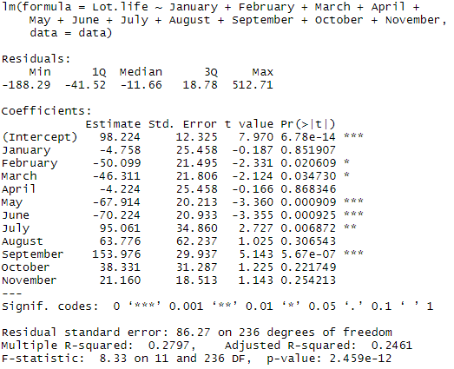
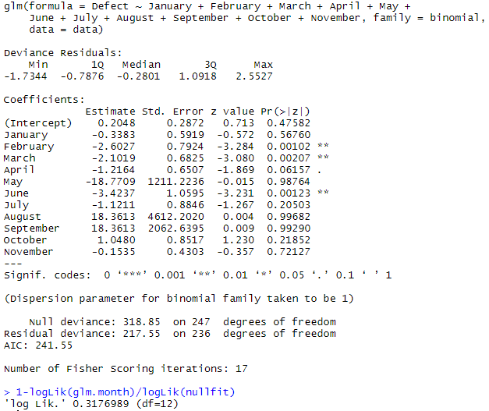

Wholesale Date
We looked at the month of wholesale two ways. We tried quarter first, with lackluster results. Logistic regression captured only 5% of the variance, and only Quarter 3 was significant, as seen to the right.
After that defeat, we considered each month vs. lot life with linear regression and each month vs. defect with logistic regression. The lot life regression did capture 28% of variance, with several months having significance, while the defect regression captured 32%. What is interesting is that different months were (for the most part) significant between the two tests, indicating that while cars that wholesale in certain months sit longer than others, those cars have a lower chance of sitting longer than 90 days. Curious…
Lot Life
Defect
Click to continue.

Slide 27
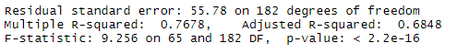
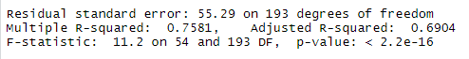
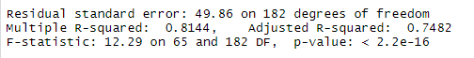
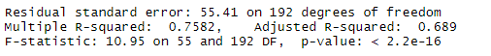

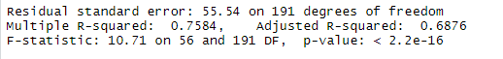
Model
Vehicle model was an interesting case. We considered model with paints and interior(1), model with the month (and quarter) of wholesale(2), model with MSRP(3), and model with color popularity(4). In each case (report snapshots are below), over 75% of the variance was captured, but only the vehicles that had very low sales numbers were significant.
Notice that in each case, the p-value is the same. Consider now the results of regressing just the model against lot life:
This is indicative that in all of the tests, only the model had any general significance.
Click to continue.

Slide 28
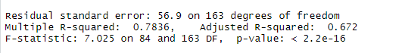
Only vehicles that had very low sales counts had any level of significance, we’d show them to you but the slide is not big enough.
Click to return.

Slide 29
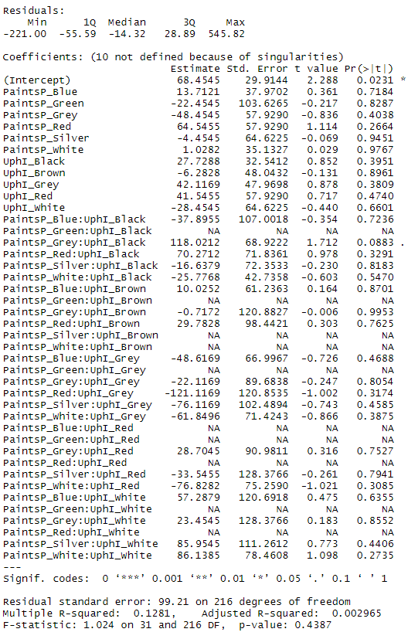
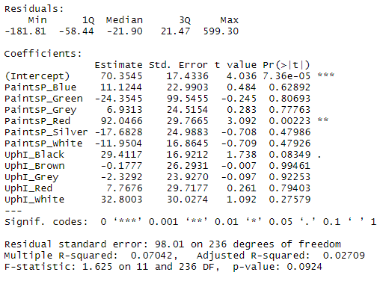
This one we can show each variable. Notice only RED paint has any real significance.
Click to return.
Notice that while this regression captured 12.8% of variance, none of the variables were significant.

Slide 30
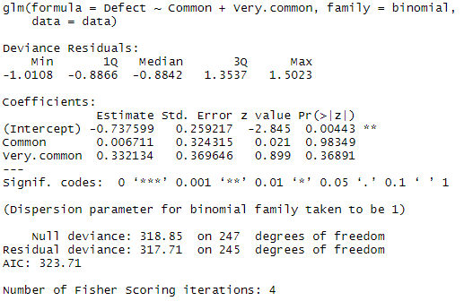
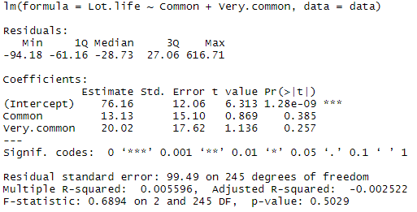
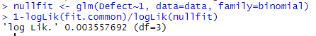

Logistic Regression
Linear Regression
McFadden’s $R^{2}$
Click to return.

Slide 31
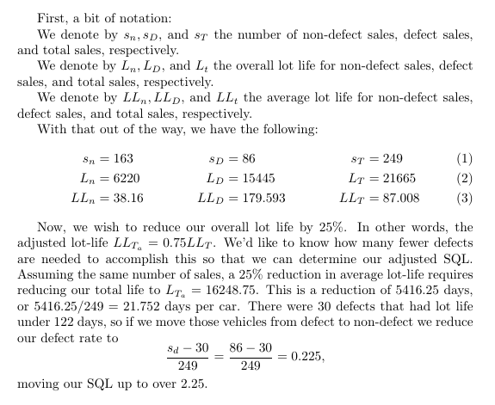
Click to return.

Slide 32
See you next term!

